Slide 1



Slide 2
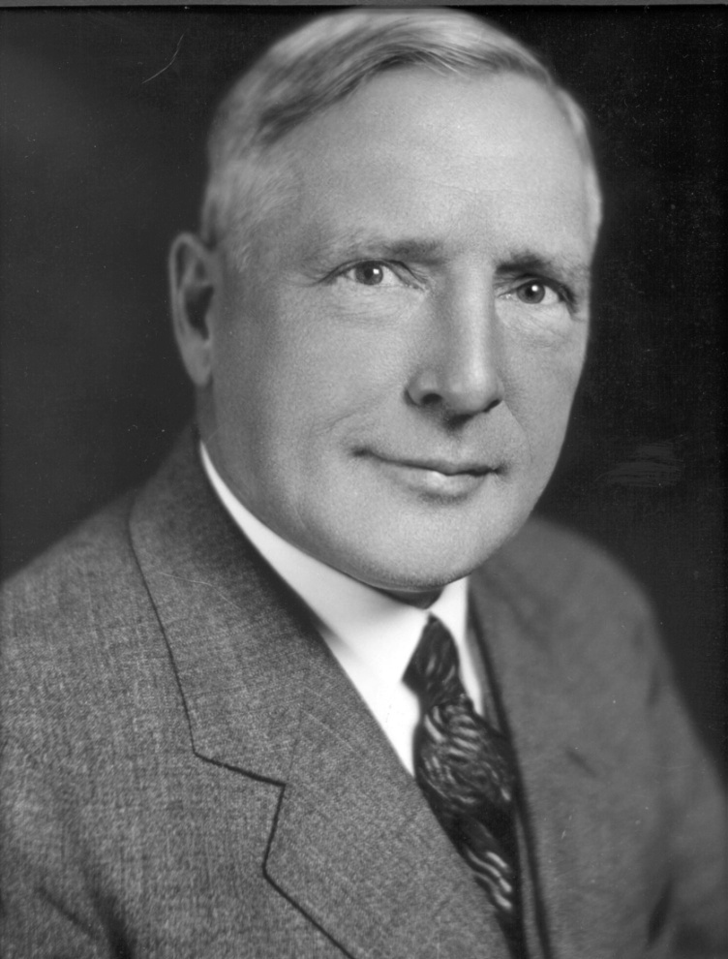
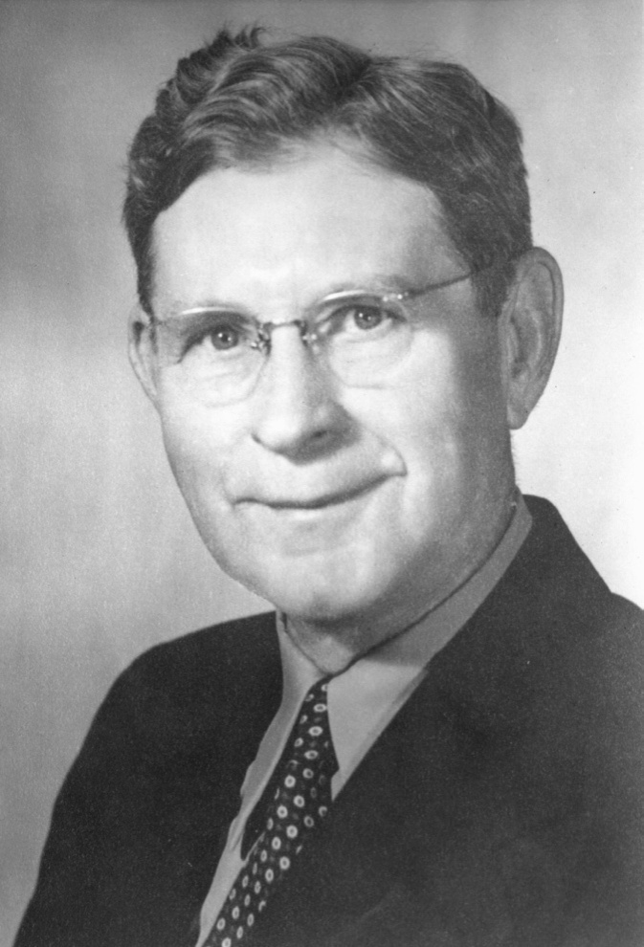

Founders
Founded by two Electric Utility Distribution Engineers from Commonwealth Edison, in Chicago.
Harry Gear
Paul Williams
Notes:
For over 100 years, G&W Electric has helped power the world with innovative power systems, solutions and products. As a leader in the marketplace, we specialize in cable accessory products and the latest in solid dielectric and SF6 switchgear, reclosers, system protection equipment and automation controls. Management’s commitment has always focused on total customer satisfaction and this value has continued to drive our success. Our company enjoys a long standing reputation for product quality, innovation and world-class service to the power industry.
We have established this reputation by believing that our greatest asset is our "PEOPLE". We owe our success to the initiative and talents of highly skilled individuals within our team-based organization. Our goal is to set the standard for customer satisfaction by ensuring a superior level of service, performance and innovation.
Since introducing the first disconnectable cable terminating device in 1905, G&W has built a reputation for innovation and reliability. During this time, we have expanded our manufacturing and sales operations. Today, we operate in over 150 countries, including manufacturing and administrative subsidiaries in Canada, Mexico, China and Brazil.
Our customers include all major investor-owned municipal and rural electric cooperative utilities, engineering firms, consultants, contractors and government agencies. Our products can be found in power stations, stadiums, commercial buildings, universities, government and military installations. In addition, G&W is on the forefront in the growth of renewable energy resources.

Slide 3
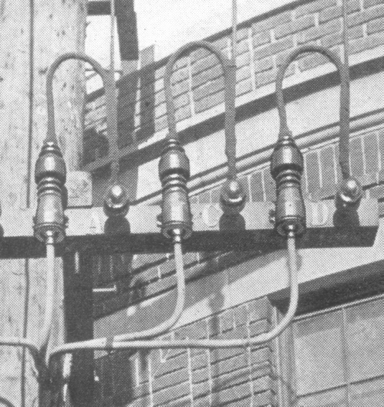
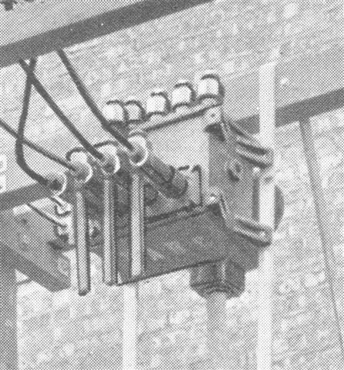
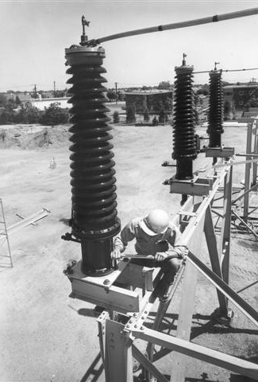
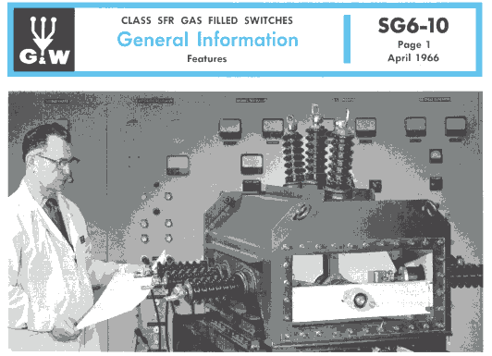
A Tradition of Innovation
1905
First Detachable Porcelain Pothead for 4kV Systems.
1925
Load break
Overhead style Oil Switches
1954
Extended ATA termination ratings to 230kV for high pressure, pipe type cables
1966
First SF6
Gas Switch

Slide 4
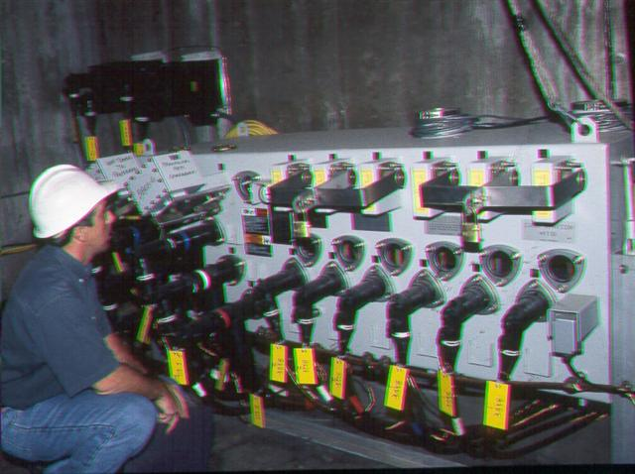
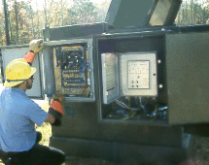
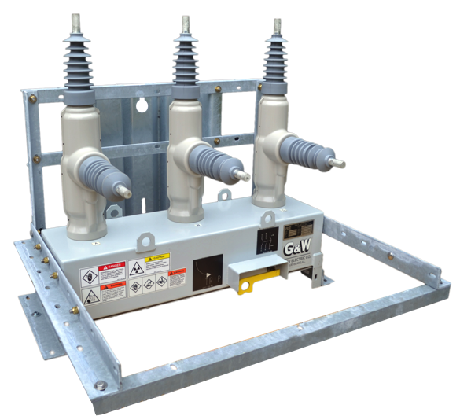
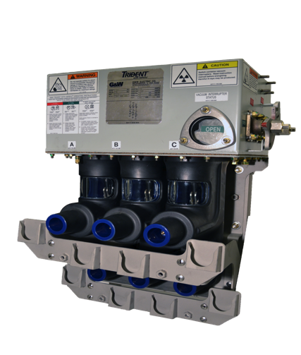
A Tradition of Innovation
1987
Introduced SCADA integrated Automatic Transfer Switch
1990
Introduced SF6 puffer vacuum interrupter switches
2001
Introduced the Solid Dielectric Recloser
2012
First Solid Dielectric Switch with visible break

Slide 5
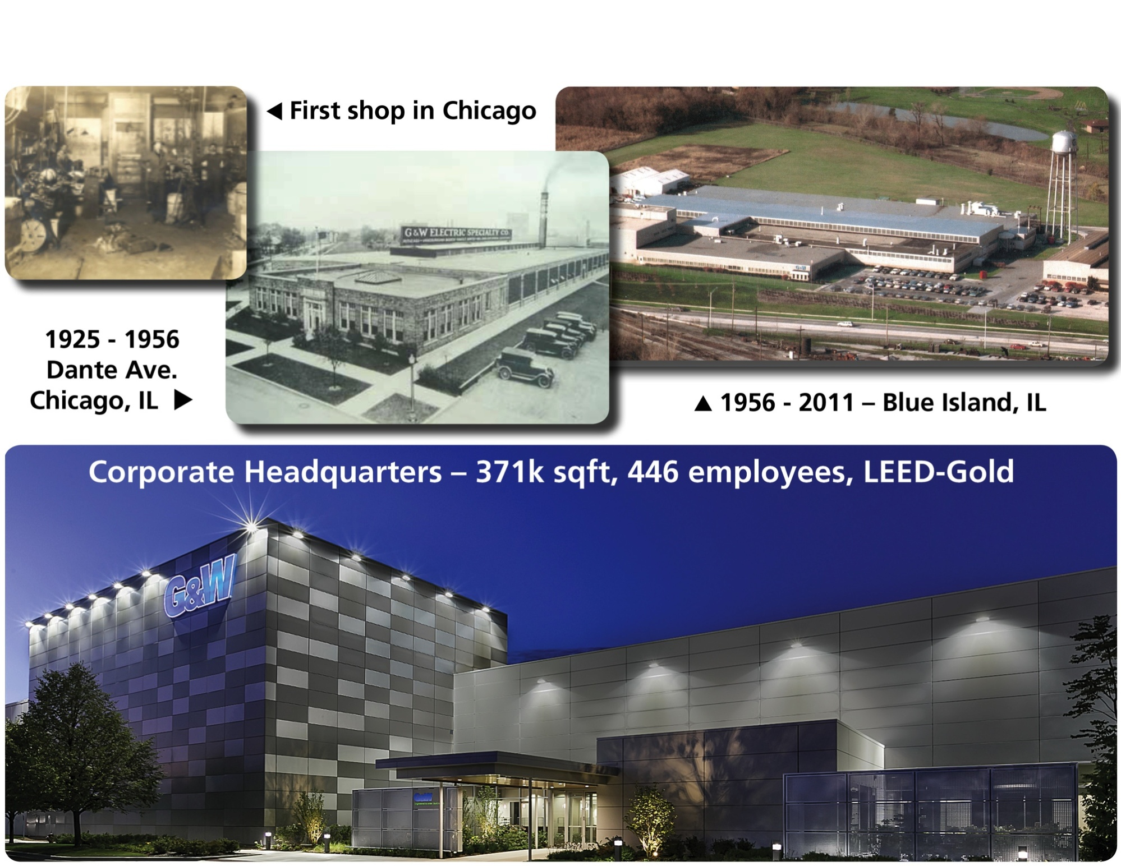
History of Manufacturing Facilities

Slide 6
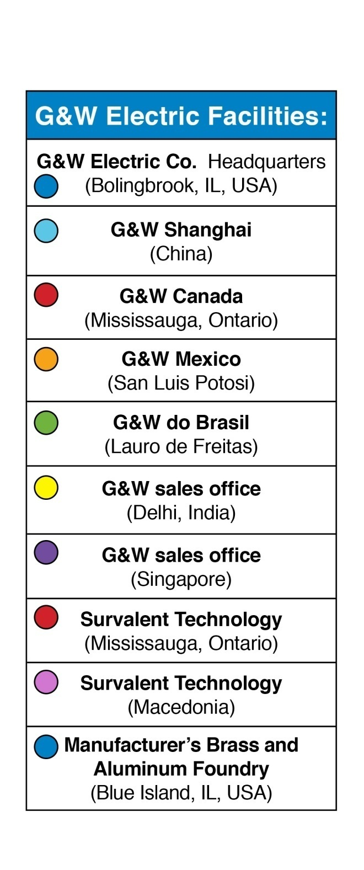
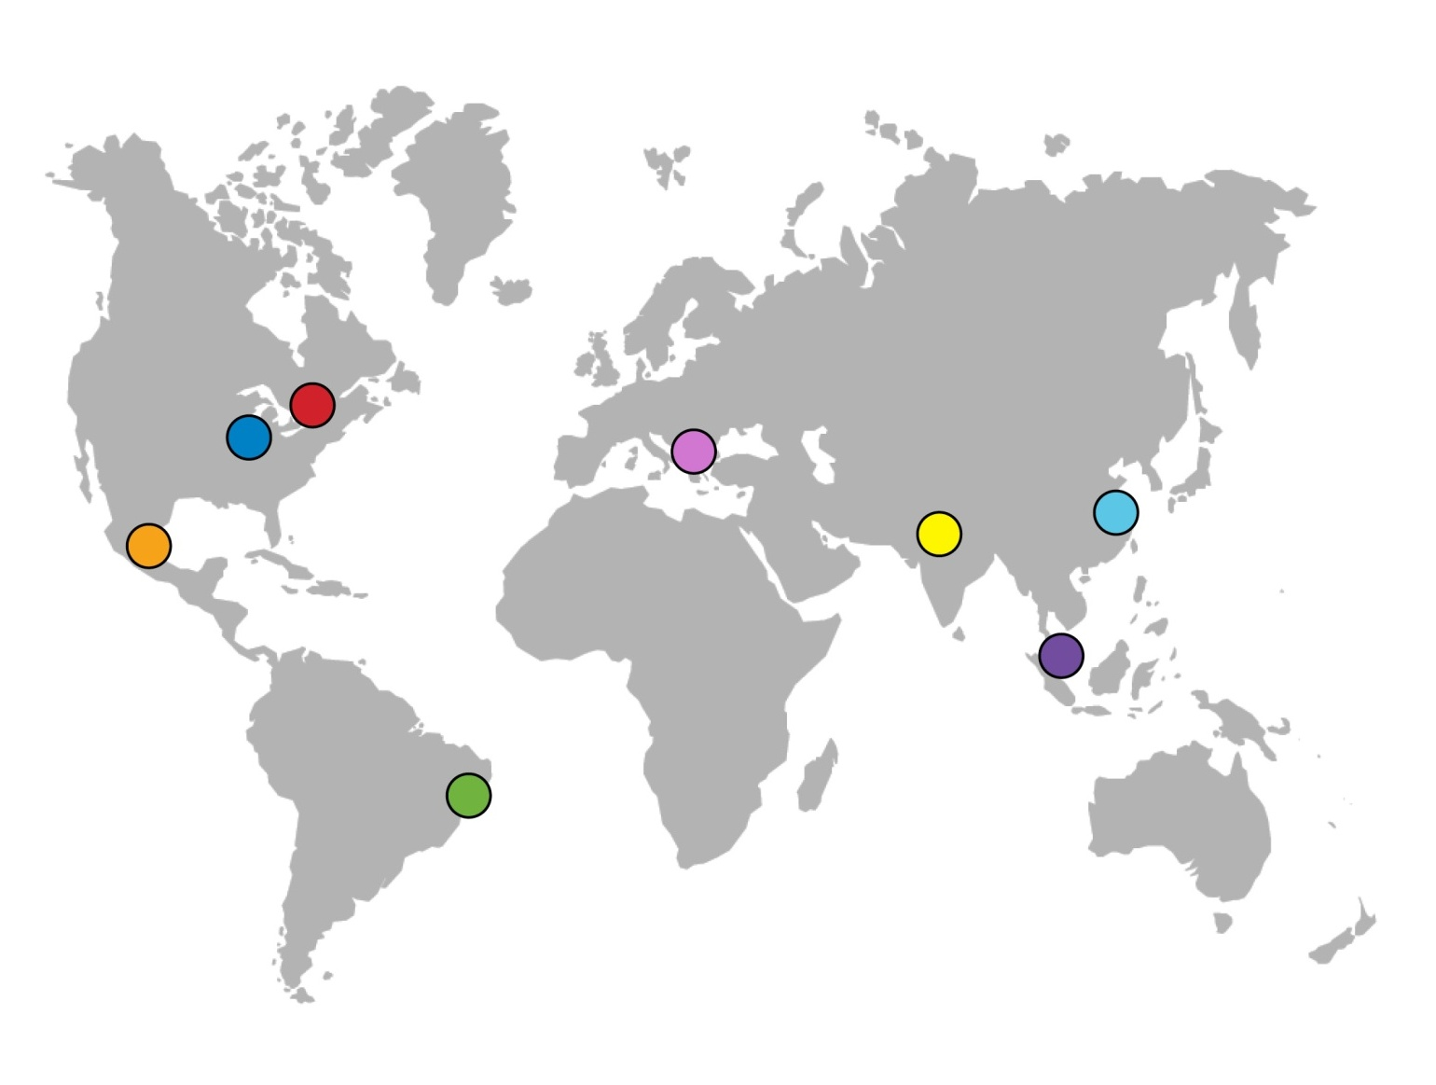
A Growing Company with a Worldwide Presence

Slide 7
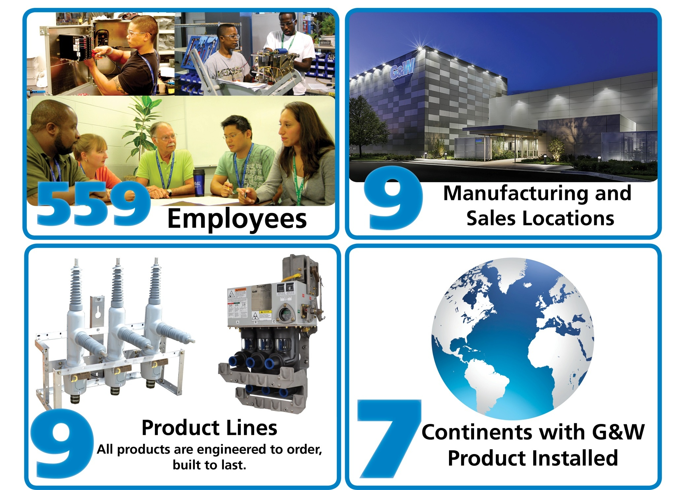
Company Statistics

Slide 8

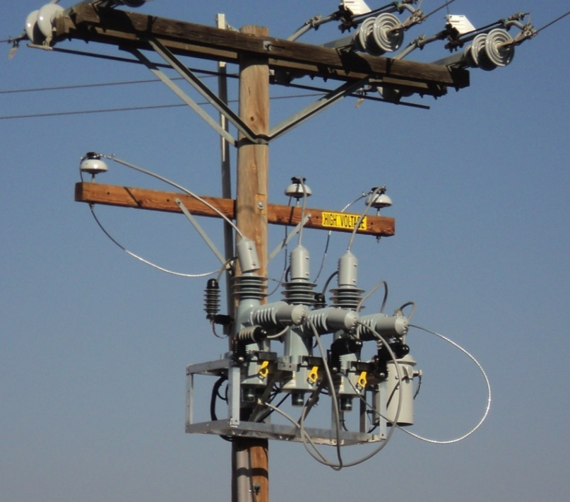
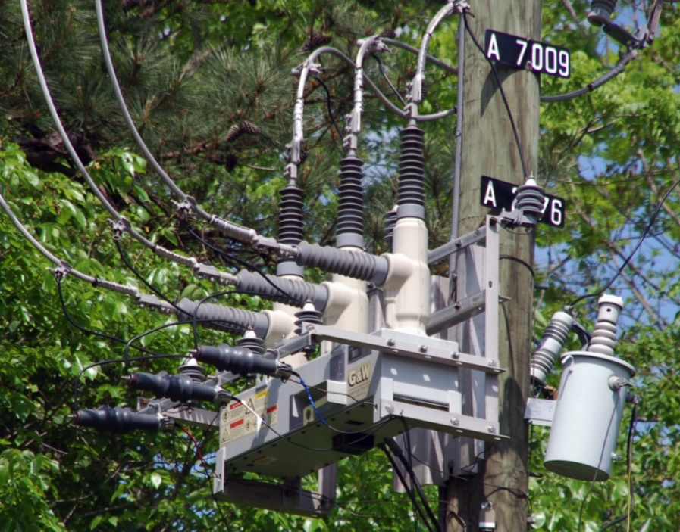
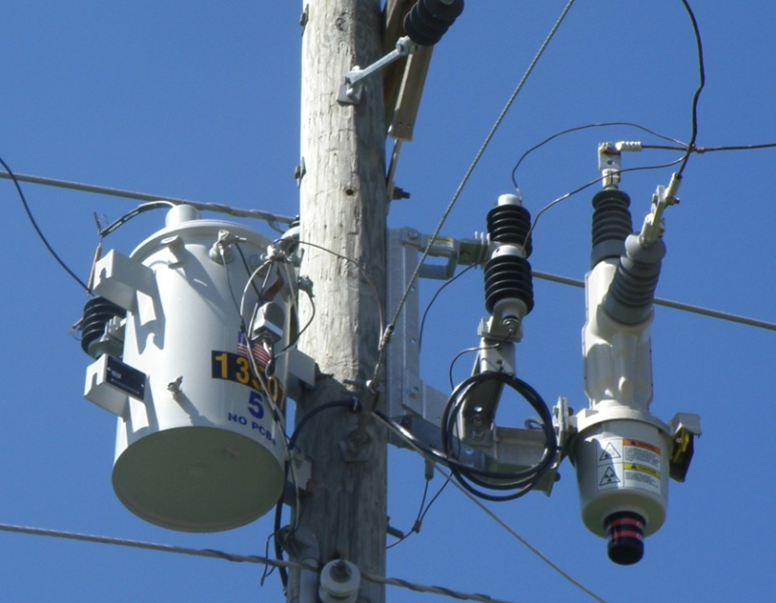
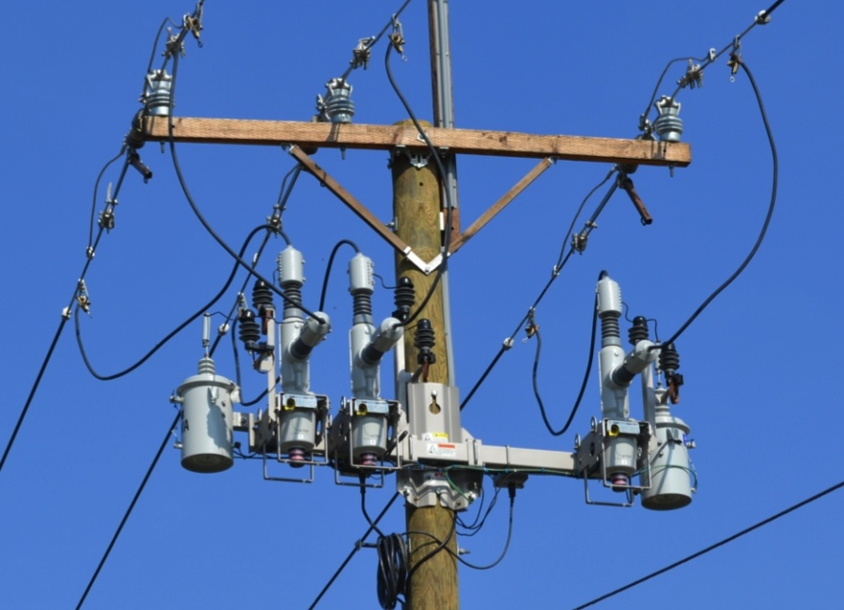
Solid Dielectric Reclosers
Viper-LT
Viper-S
Viper-SP
Viper-ST

Slide 9
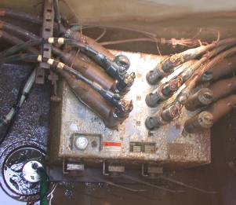
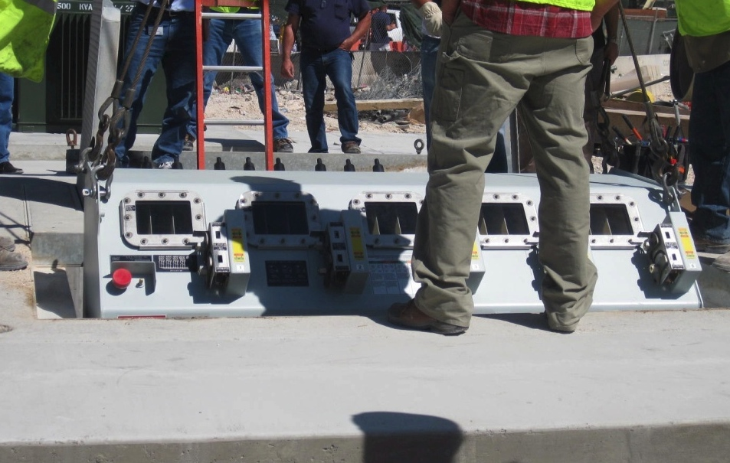
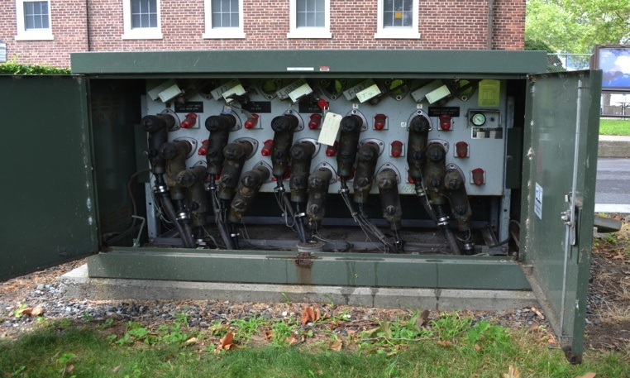
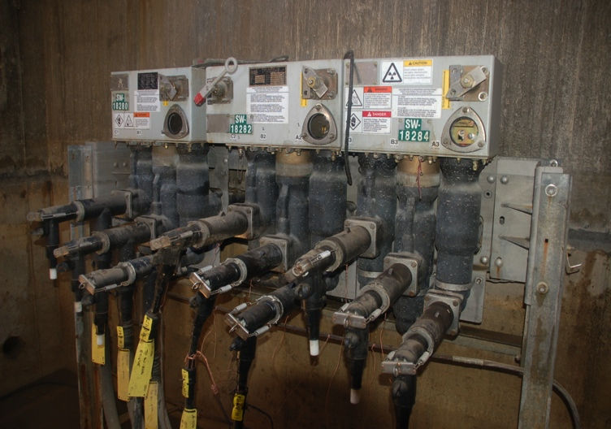
G&W Switchgear

Slide 10

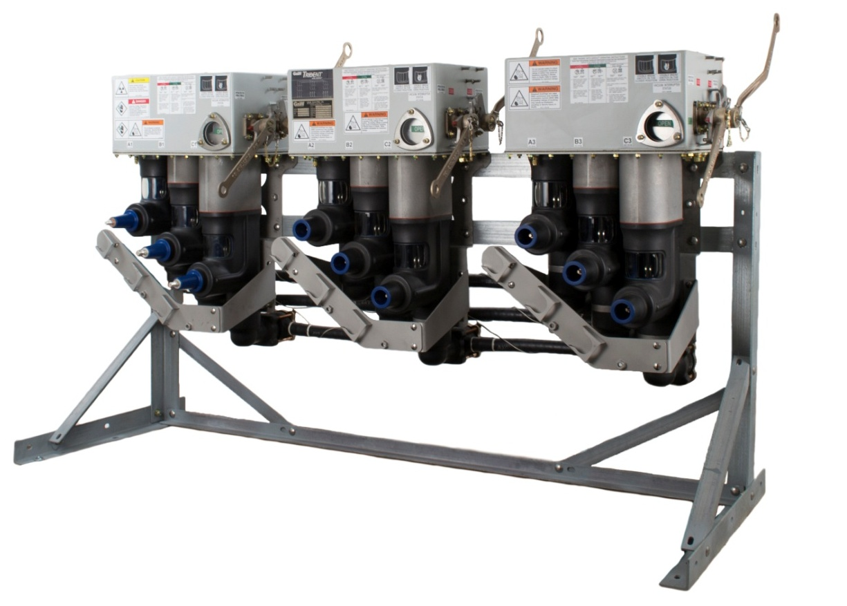

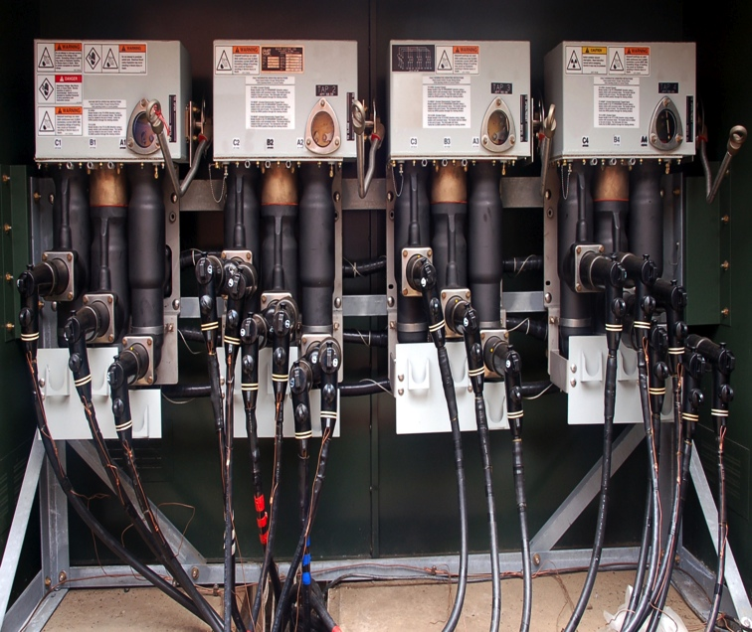
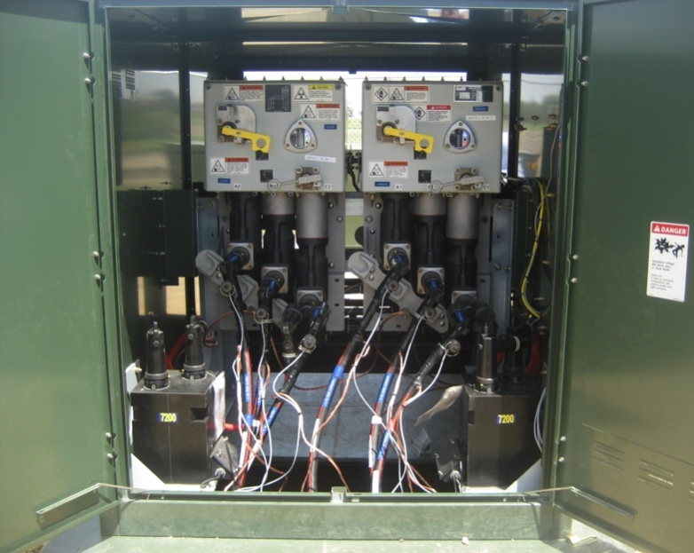
Solid Dielectric Switchgear

Slide 11

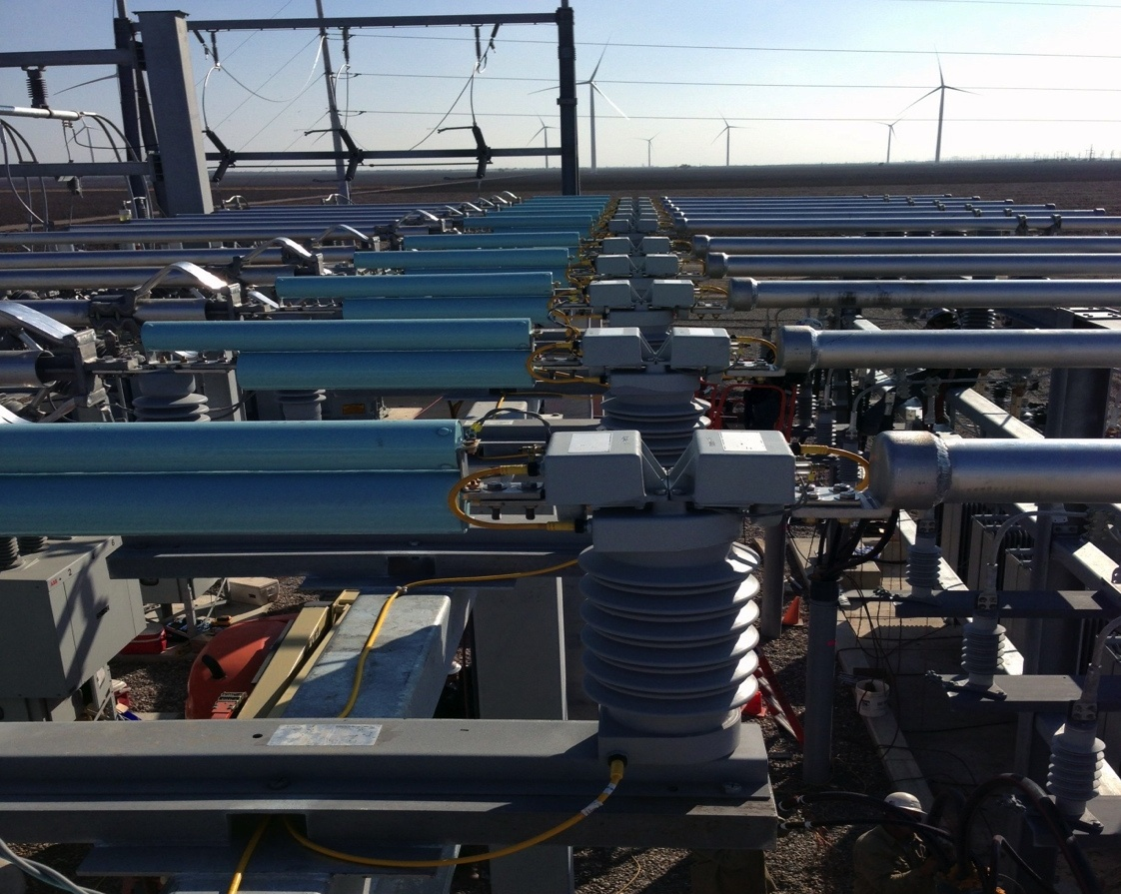
High Continuous Current
Limiting Protectors
Notes:
One of the first automation products, long before the current efforts, was an automatic switch that helped maintain a power source for critical loads. This switch was installed to provide opoiwer to a hospital in New England.

Slide 12
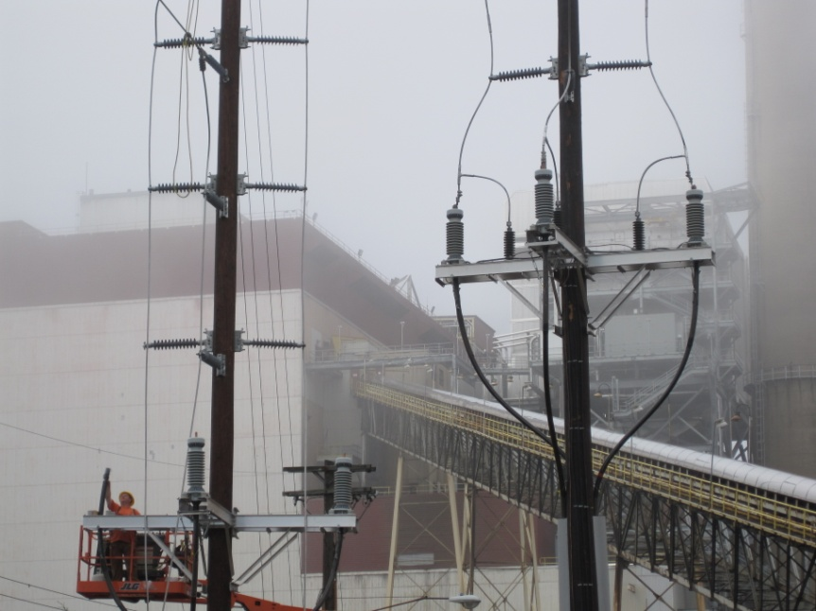
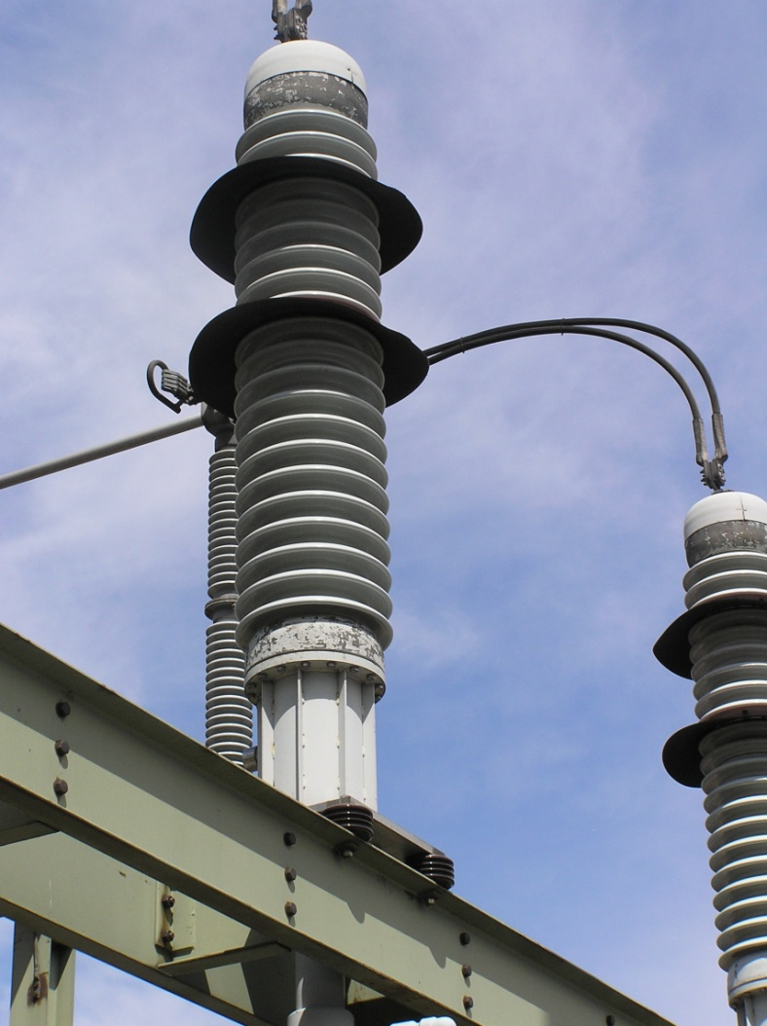
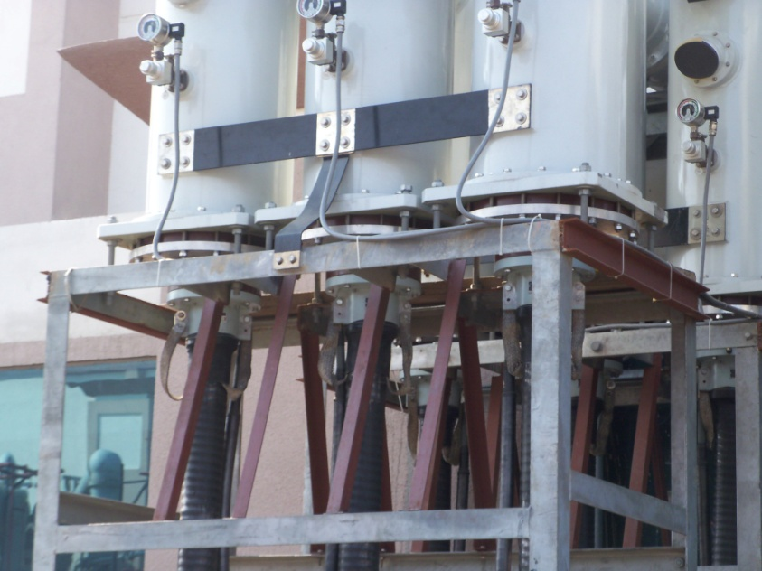
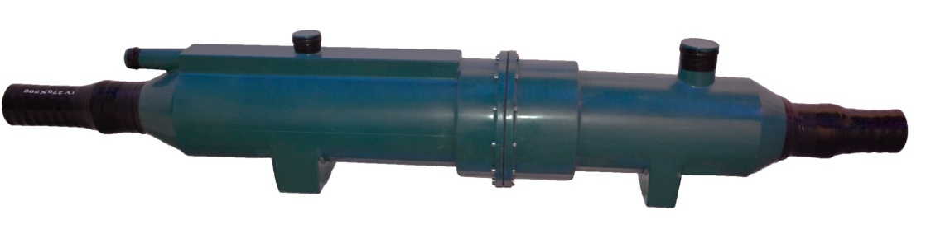
Cable Accessories

Slide 13
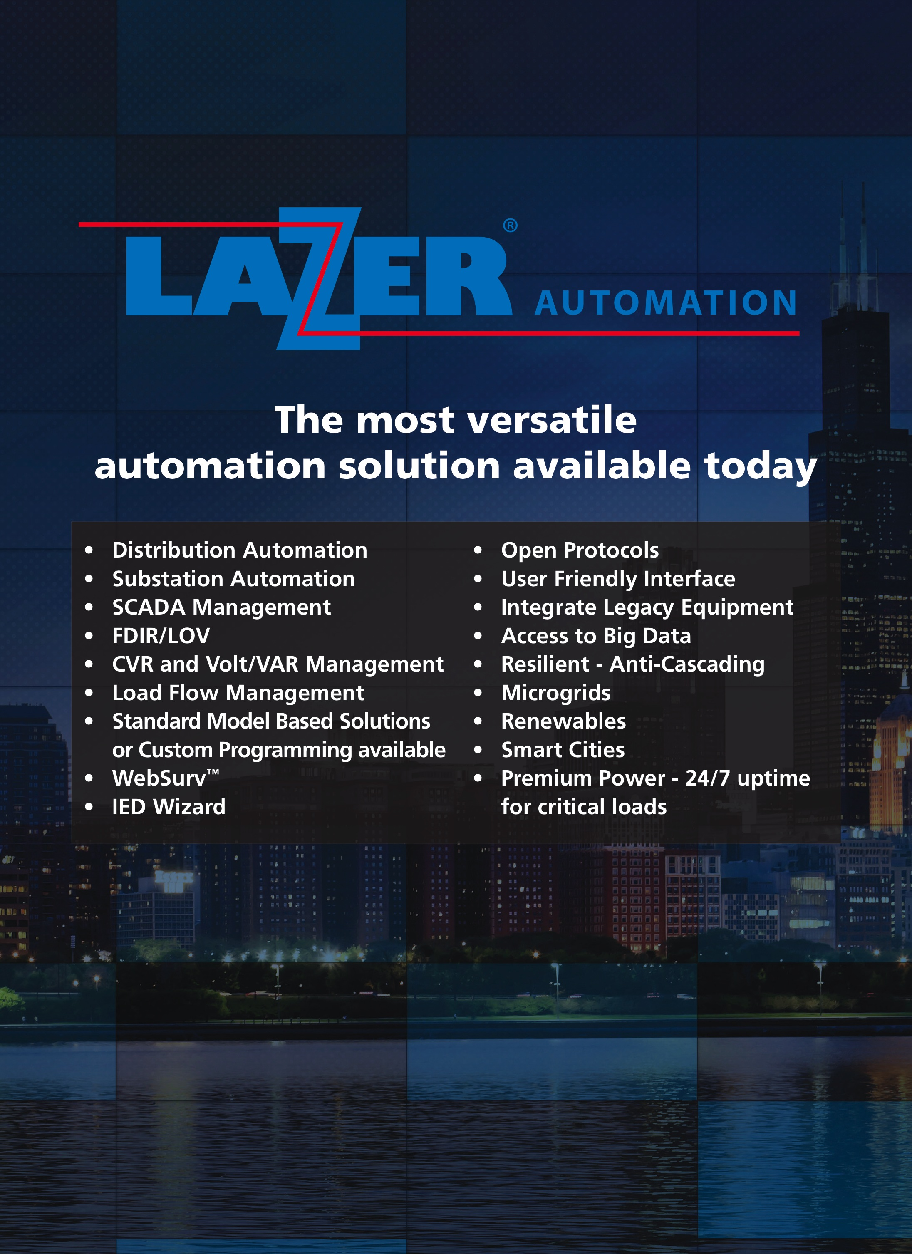

Slide 15
Sunny GONG
Managing Director (90)
Robert YANG
Director
Sales (13)
Michael ZHENG
PM
HVCA
Anne JIANG
Leader
Pricing, Export
Grand WU
Manager
Eng HVCA (5)
Annie ZHANG
Manager
HR (5)
Wilson WANG
Manager
Procurement (4)
Vivian SHI
Controller
Finance (4)
Patrick SUN
Manager
Eng SWG (11)
LIU Yu
Director
Operation (41)
LI Wei
Manager
Quality (4)
G&W (Shanghai) Electric

